Slide 1





LikelyWho?
Project
Presentation
Carlotta Anna Maria Ciani 1881291
Michela Fuselli 1883535
Silvia Macagnano 1796039
Chiara Maccabruno 1946328
Antonella Mei 1887894

Slide 2

Description
The LikelyWho? is a distributed social game where groups of users answer fun questions such as “Who among us is most likely to finish the wine bottle first?”.
Each participant votes for another group member and aggregate votes will be displayed in a leaderboard (most voted wins).
You can create a new question whenever you want and if you’re out of ideas, just pick a category and a random question will be generated by the system! Anyone that has an account can be invited to join the group thanks to an invitation code sent by a participant.

Slide 3



Key features
Log-in and Authentication
Group creation and joining
Creation of a new question
Voting for a group member during the question session
User profile management

Slide 4


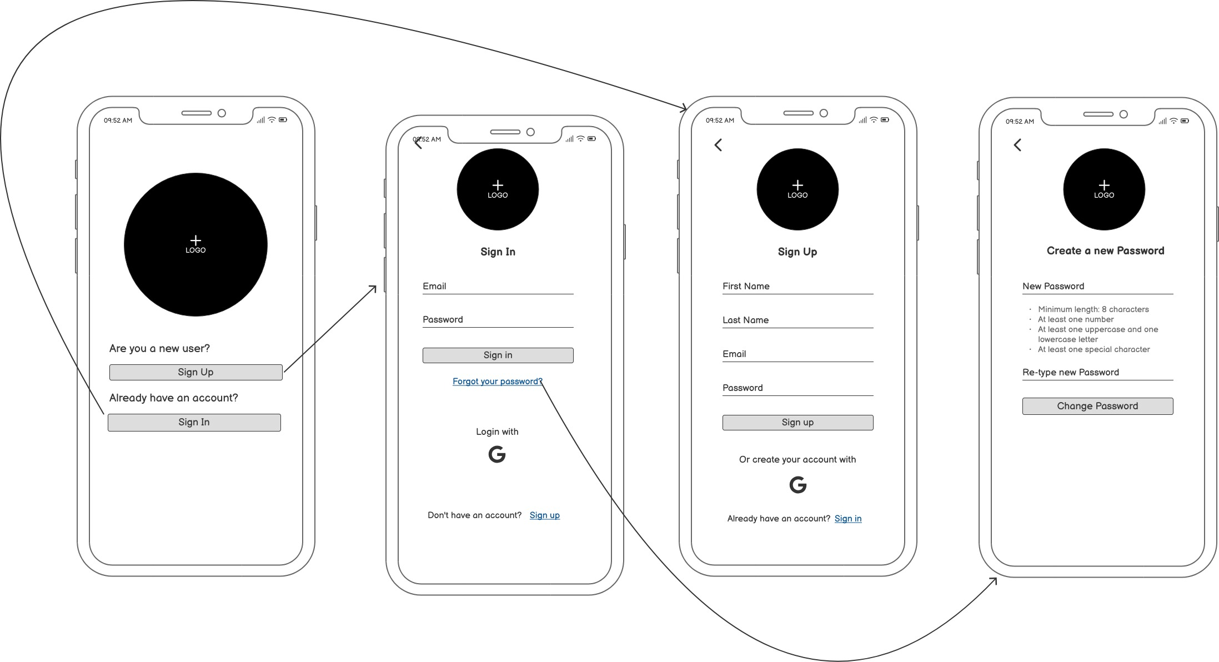

User stories and Mockups
As a user, I want to create an account using my email or social login, so that I can participate in voting sessions securely.
As a user, I want to reset my password in case I forget it, so that I can regain access to my account.
As a user, I want to log in securely, so that my scores and history are saved.

Slide 5
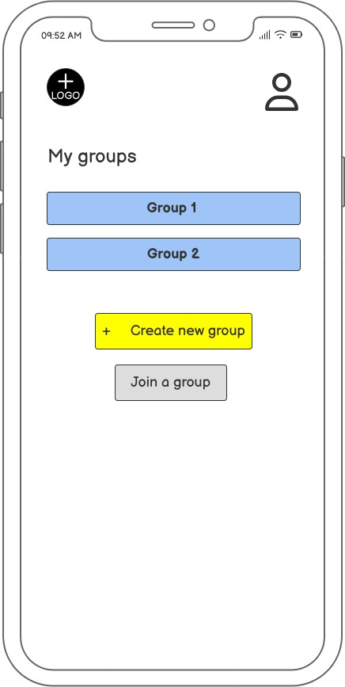
User stories and Mockups
As a user, I want to have all groups in the home page, so that I can access them easily.

Slide 6
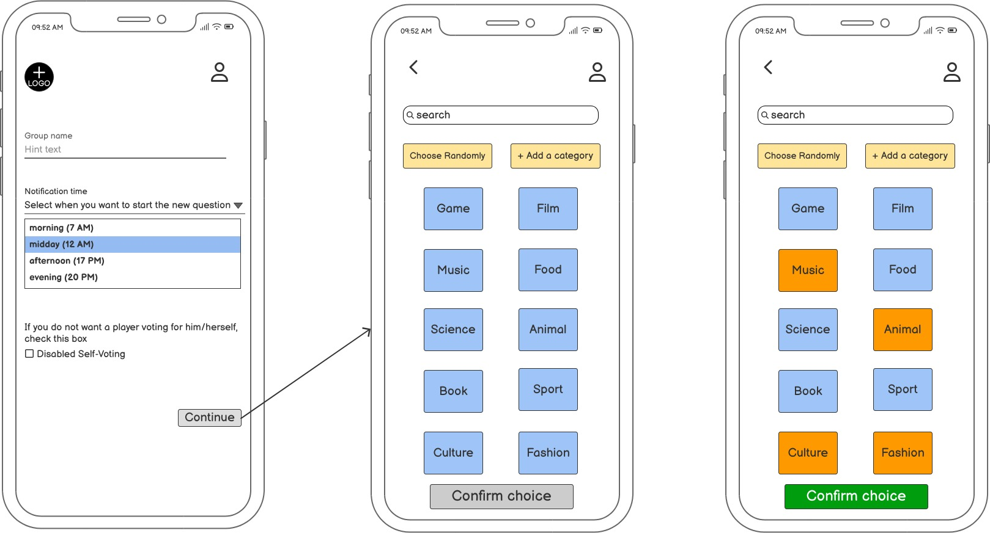
User stories and Mockups
As a user, I want to ask the system to generate a category randomly, so that the voting questions are relevant to my group.
As a session leader, I want to disable the self-voting choice, so that no participant can vote for themselves.
As a session leader, I want to choose a predefined category or enter a custom topic, so that the voting questions are relevant to my group.

Slide 7
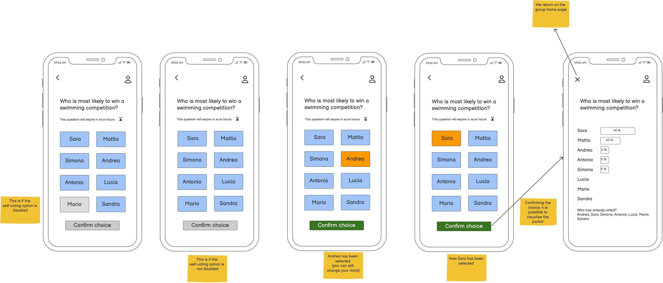
User stories and Mockups
As a user, I want to vote for one of my friends in response to the question, so that my choice is counted.
As a user, I want to see the final results after voting ends, so that I can see who got the most votes.

Slide 8
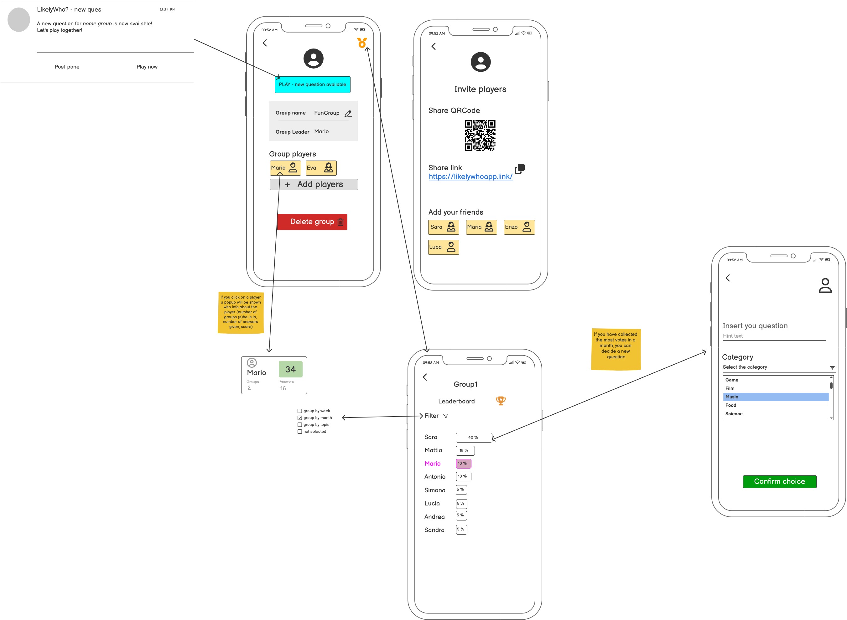
User stories and Mockups
As a user, I want to see a leaderboard of my friends, so that I can compare scores.
As a user, I want to create a voting session and invite my friends via a code, so that we can vote together and I can become the session leader.
As a user, I want to earn points when I receive the most votes, so that I can track my progress.

Slide 9
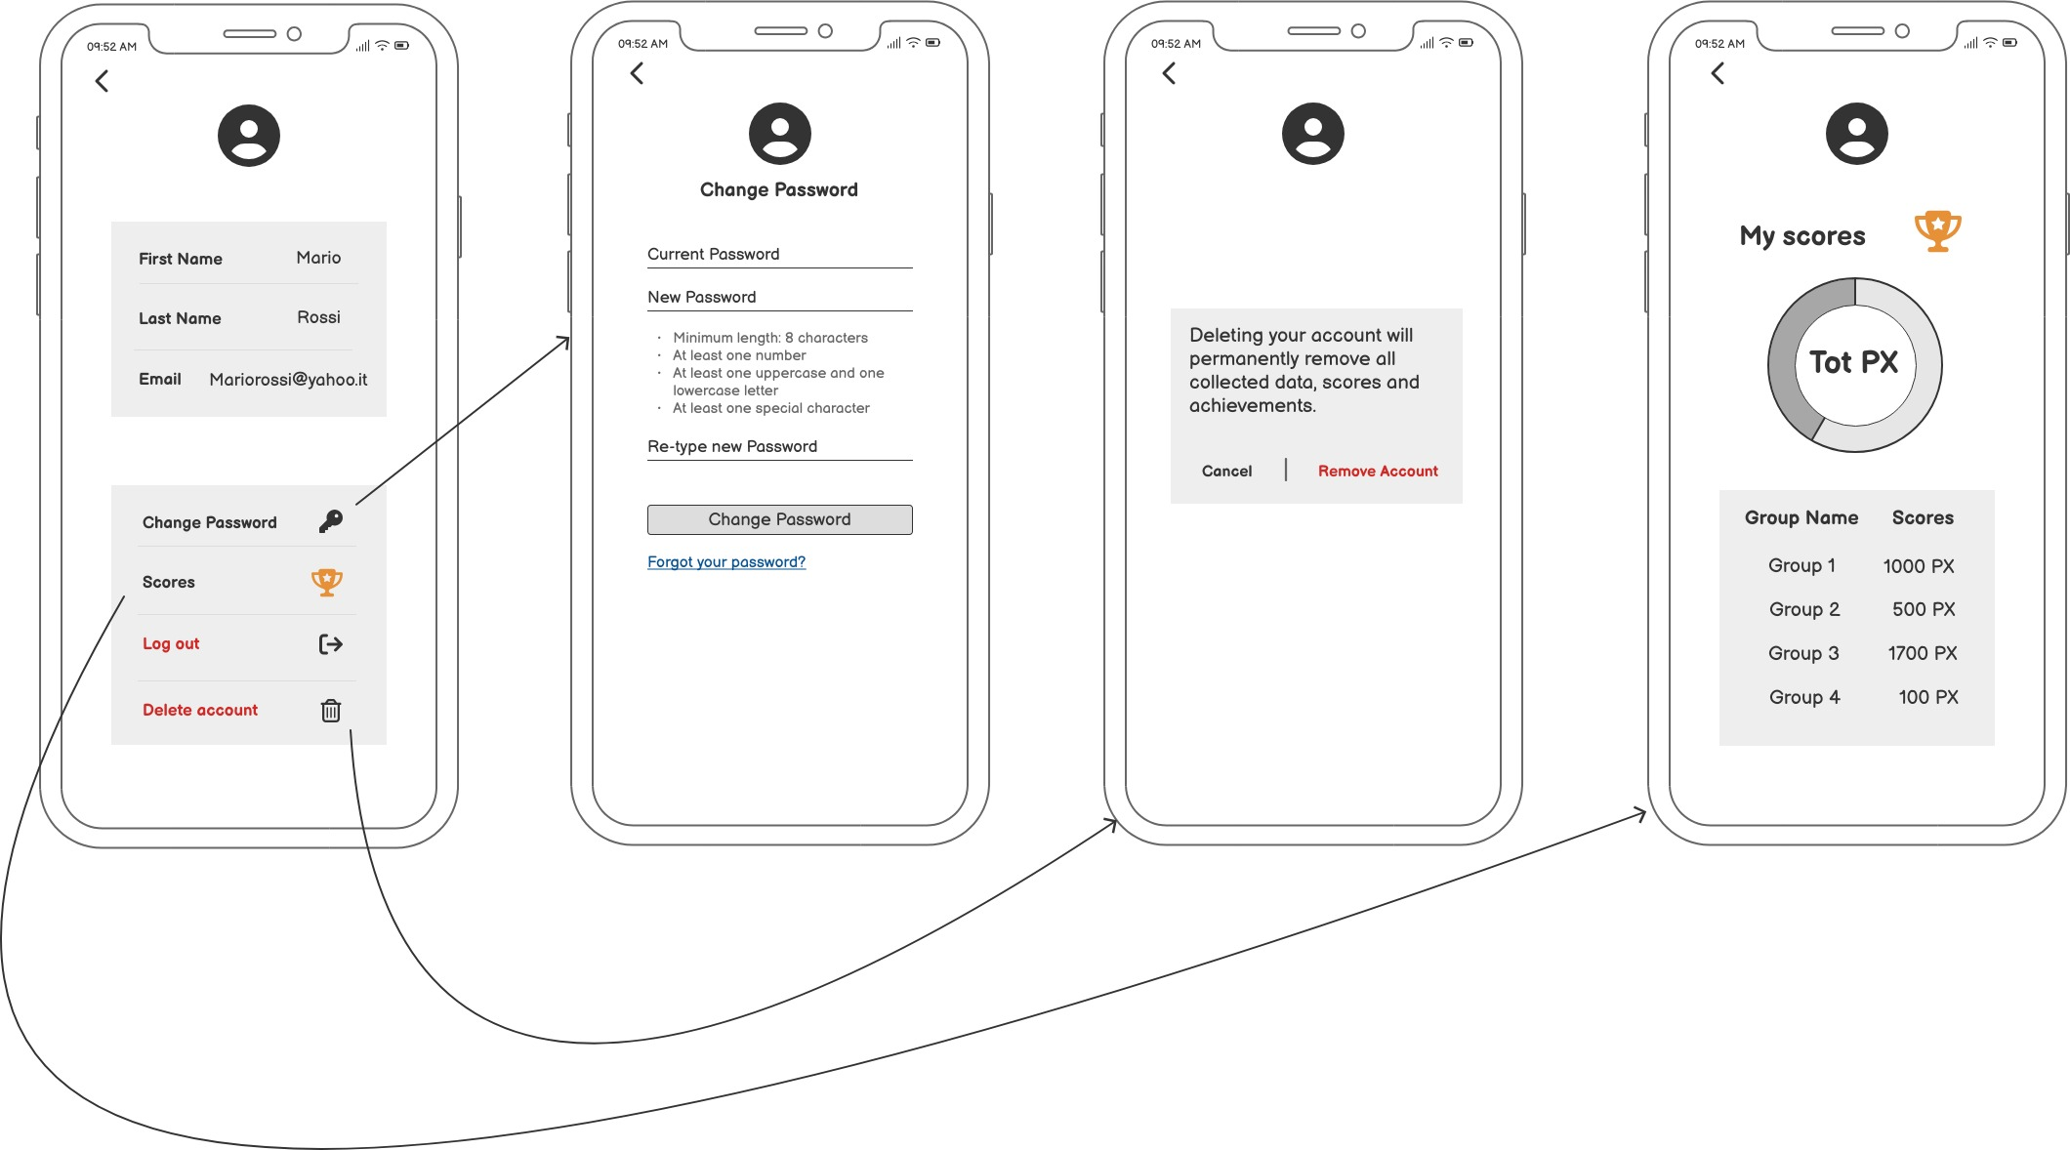
User stories and Mockups
As a user, I want to see my position on the leaderboard, so that I know where I rank in the group.
As a user, I want to log out of my account securely, so that I can protect my data on shared devices.
As a user, I want to edit my profile (e.g., name, profile picture), so that my friends can recognize me easily in the app.

Slide 10
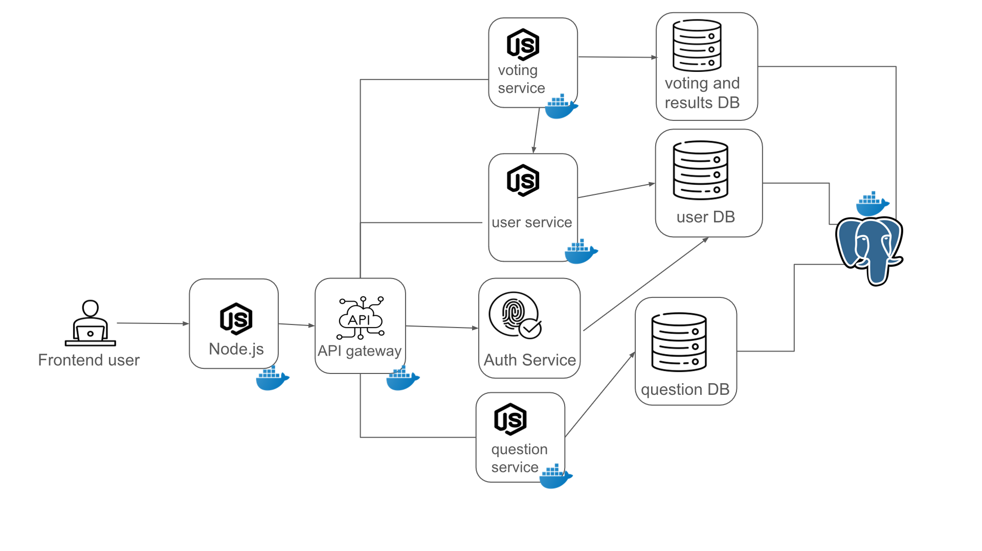
Architecture

Slide 11
Technologies
All those microservices are deployed in their own containers in Docker.
The technologies used to implement the web app are:
React (frontend)
PostgreSQL (DB)
Express for the API-gateway
Microservices
User Service
Voting Service
Authentication Service
Question Service

Slide 12

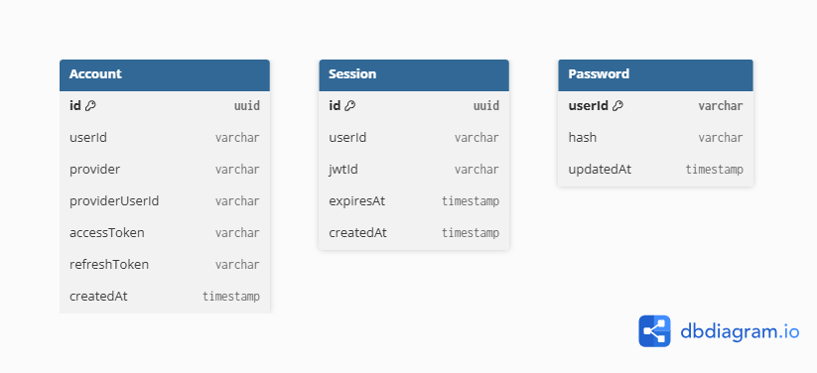
Authentication service - database
Handles authentication: accounts, password login, and session management. It contains three entities: Account for login, Password with the hash for local login, and Session.
Links to users are logical through userId, so the microservice stays independent.

Slide 13
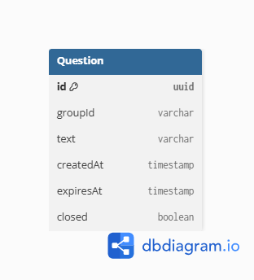
Question service - database
Creates and manages group questions, with a validity window and closed status. The Question entity is linked logically to a group through groupId.
For each question it stores fields like text, creation date, expiration (expiresAt), and a closed flag to stop interactions after the window.

Slide 14
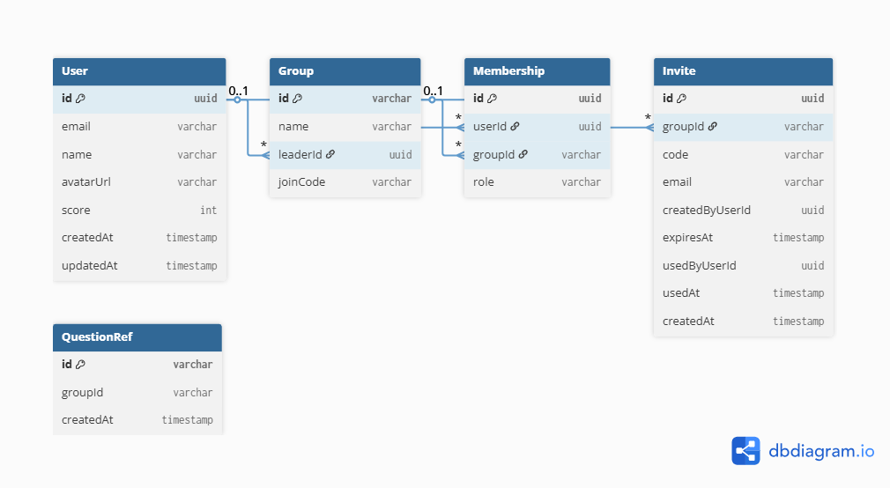
User service - database
Scope: Manages application identity: users, groups, memberships, invites, and references to questions. User is the main entity. Group has a leader (leaderId) and can expose a joinCode for entry. Membership connects users and groups via (userId, groupId). Invite manages invite codes. QuestionRef only stores IDs of external questions.

Slide 15
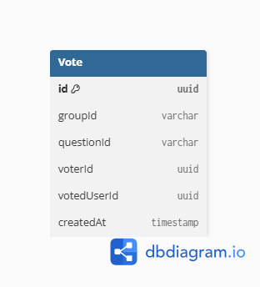
Voting service - database
Scope: Records votes for each question in a group, making sure each voter can vote only once per question. Vote stores “who votes for whom” on a given questionId inside a groupId. The uniqueness constraint on (questionId, voterId) prevents duplicate votes.

Slide 16
Function points
It is a method used to estimate the size and complexity of a software project, based on what the system does, not how it's implemented.
ILF (Internal Logical Files): Data maintained within the system
EIF (External Interface Files): Data used by the system but maintained
externally
EI (External Inputs): Data coming into the system
EO (External Outputs): Processed output with internal logic
EQ (External Queries): Simple data retrieval operations
Estimated Software Size: 2.5 KLOC

Slide 17
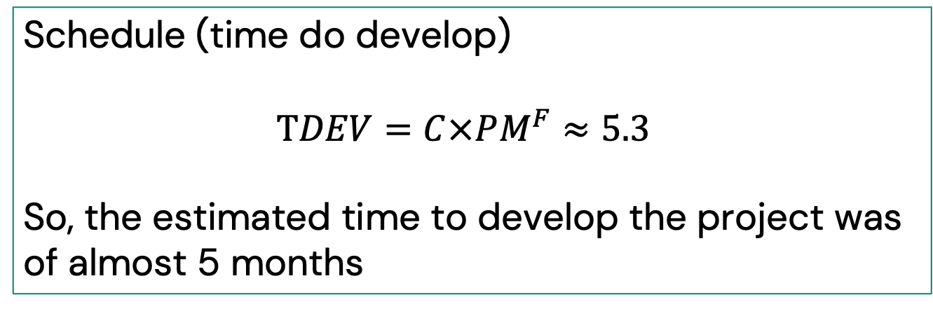
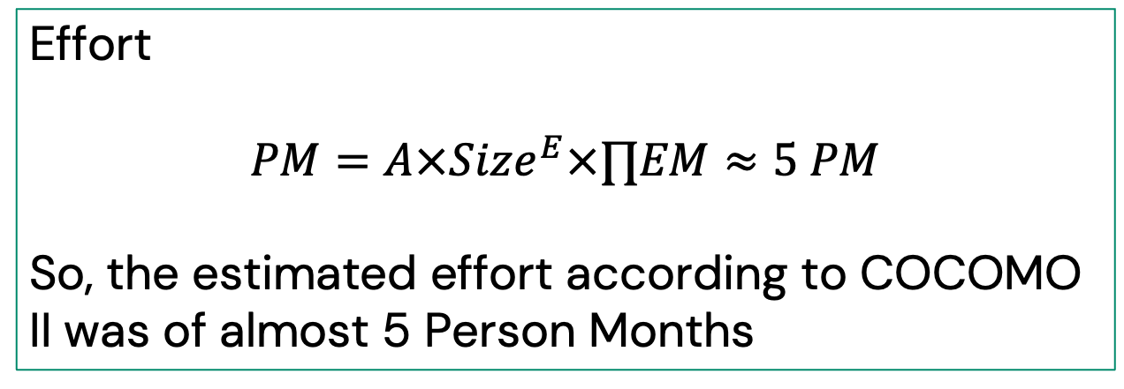
COCOMO II
post- architectural model
Effort
$$PM=A×Size^{E}×∏EM≈5 PM$$
So, the estimated effort according to COCOMO II was of almost 5 Person Months
Schedule (time do develop)
$$TDEV=C×PM^{F}≈5.3$$
So, the estimated time to develop the project was of almost 5 months
Despite COCOMO II predicting 5 PM and a 5-month schedule, we successfully delivered the project in 4 months with a 5-person team.
How we achieved this:
Full parallelization of tasks across frontend, backend, and DB.
Resource optimization
Strict scope control to prevent feature creep and keep the workload stable.
Efficient collaboration with clear responsibilities and agile sprints.

Slide 18
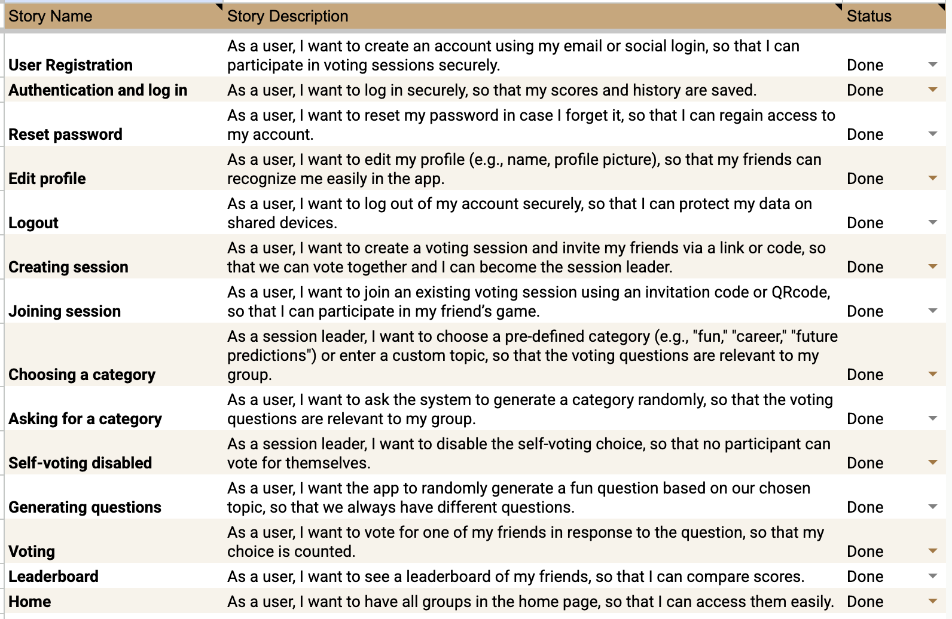
Product backlog

Slide 19
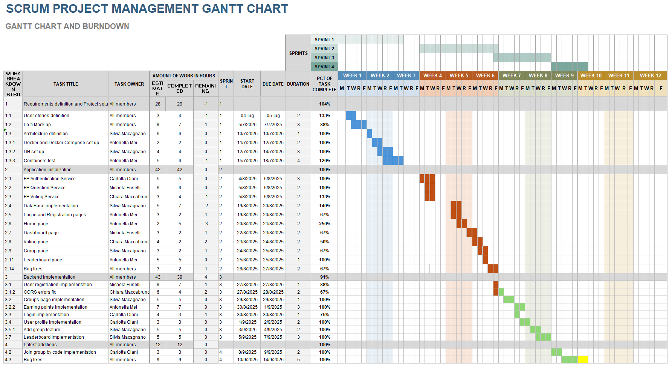
SCRUM

Slide 20
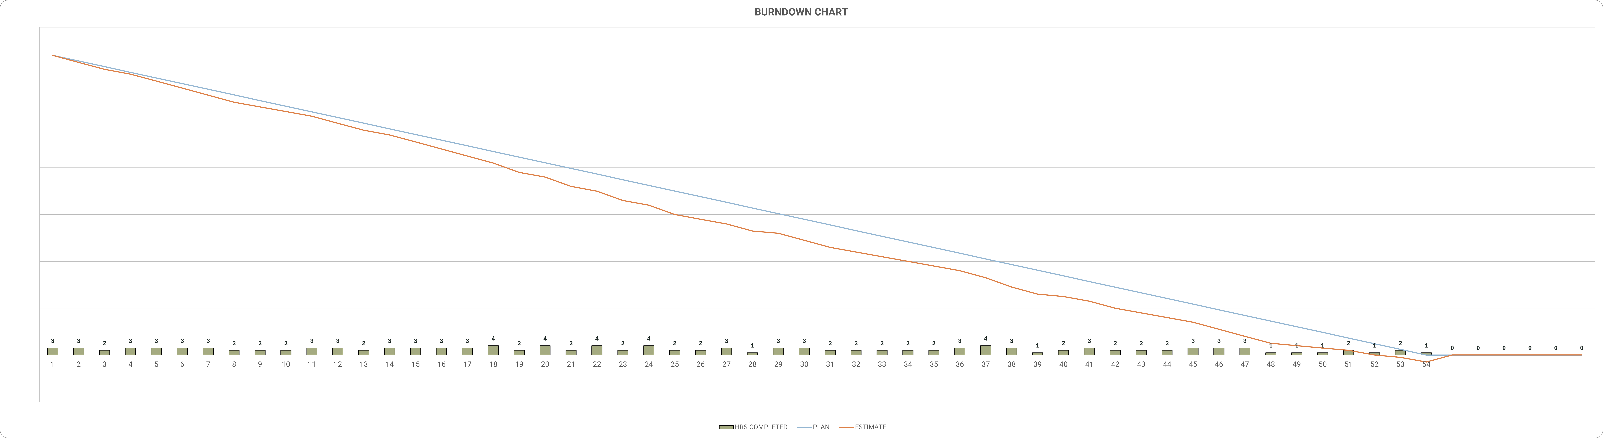
SCRUM – Burndown chart

Slide 21

Thank
You!

